Slide 1
Real Time Weapon Detection
Alaa Senjab

Slide 2
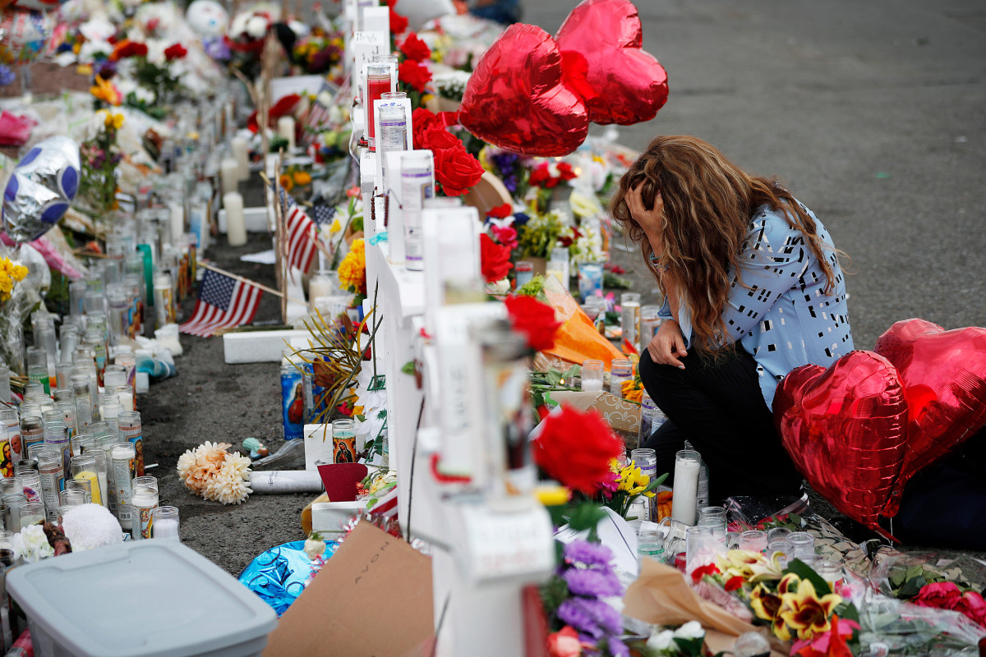

Slide 3
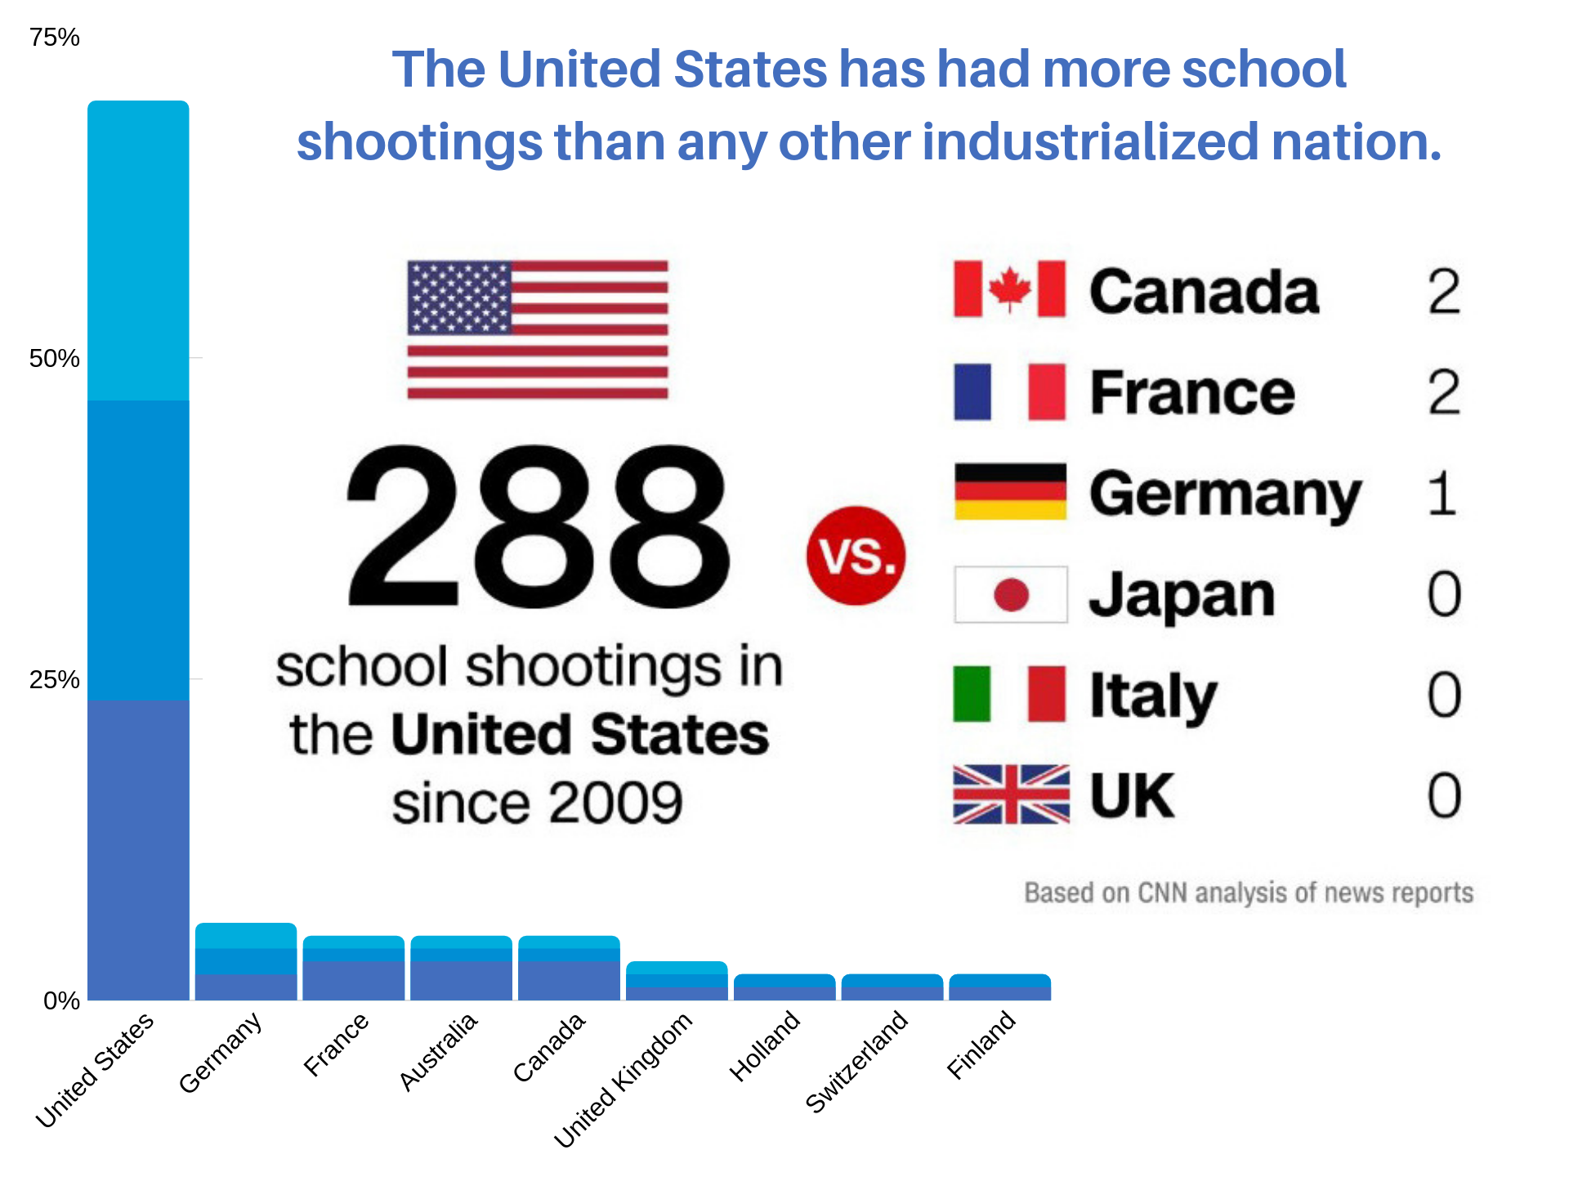

Slide 4
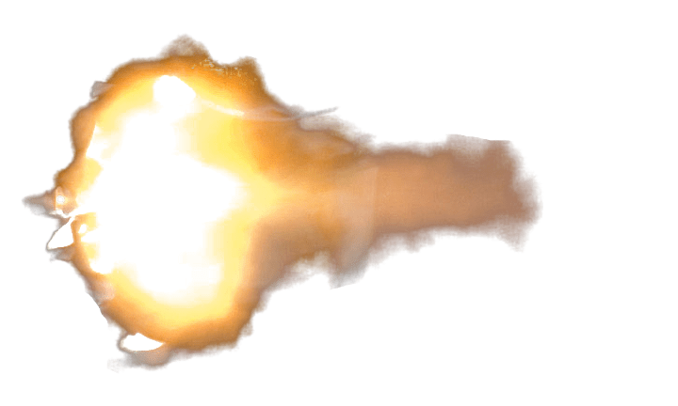
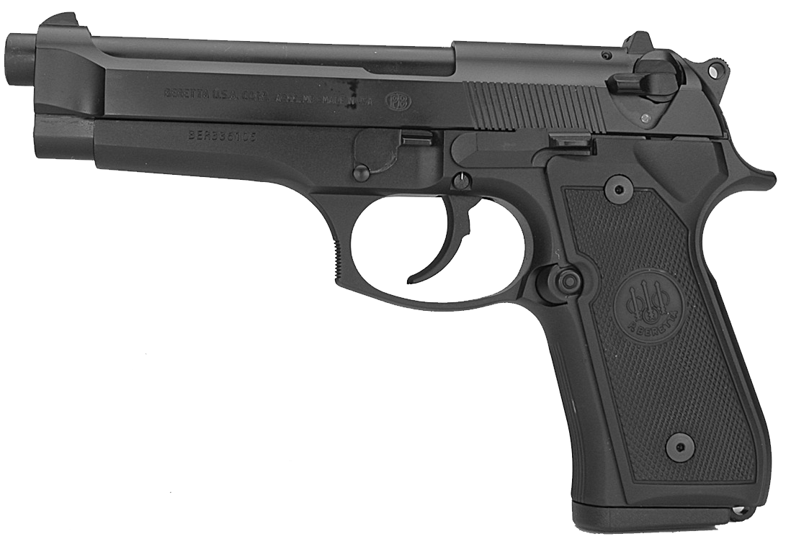
The Response Time of a Pistol is1400 Feet Per Second
The Average Response Time of a 911 Call is 23 minutes

Slide 5
My Proposal

Slide 6
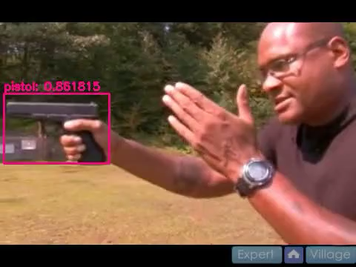

Slide 7

The Data

Slide 8
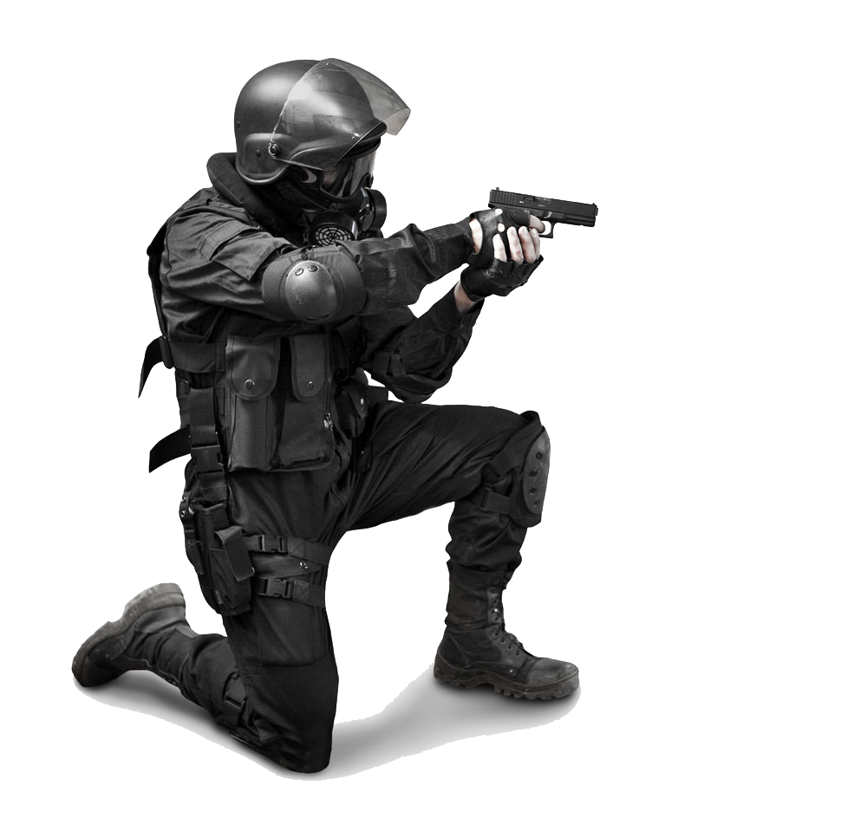
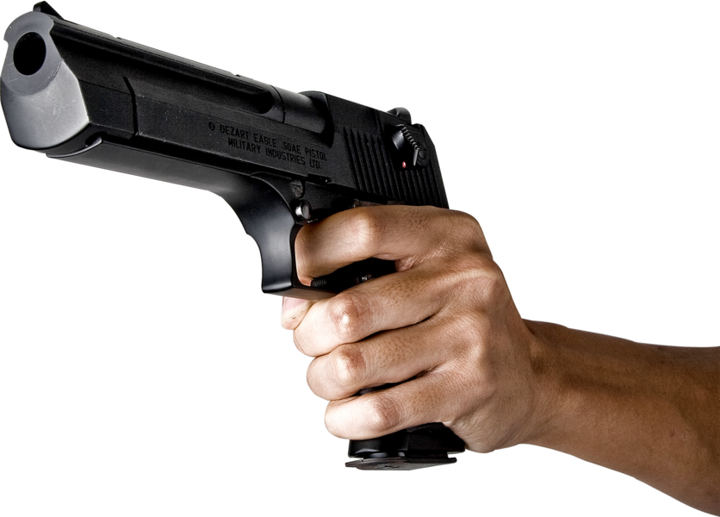
The Data

Slide 9
Preprocessing

Slide 10
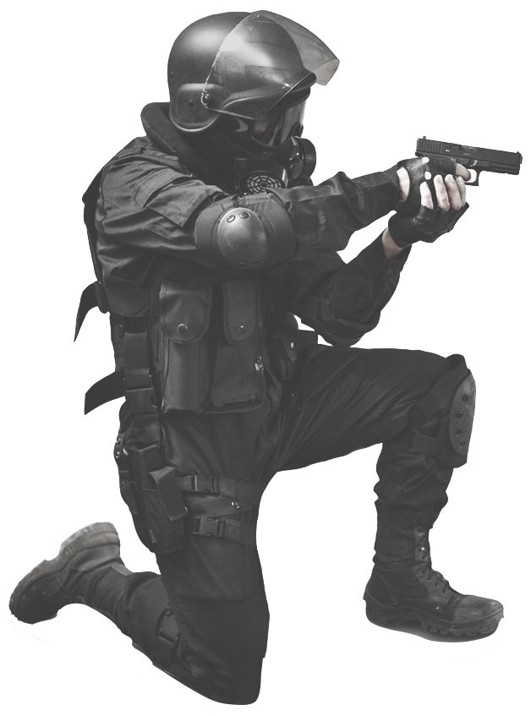

Slide 11
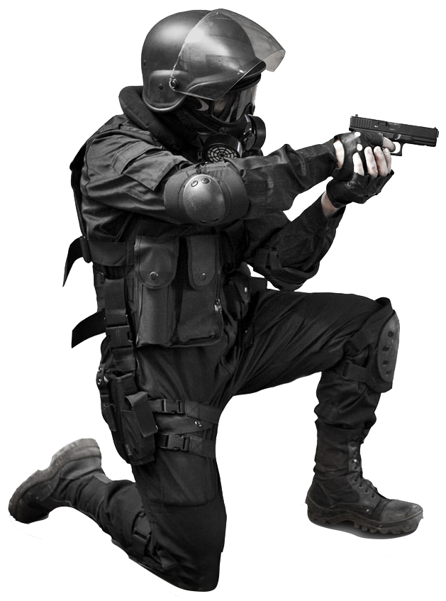

Slide 13
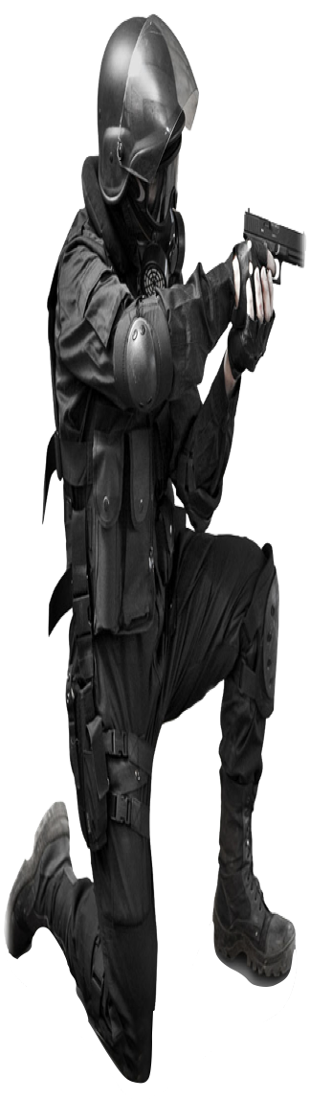

Slide 15
How does the training work?

Slide 16
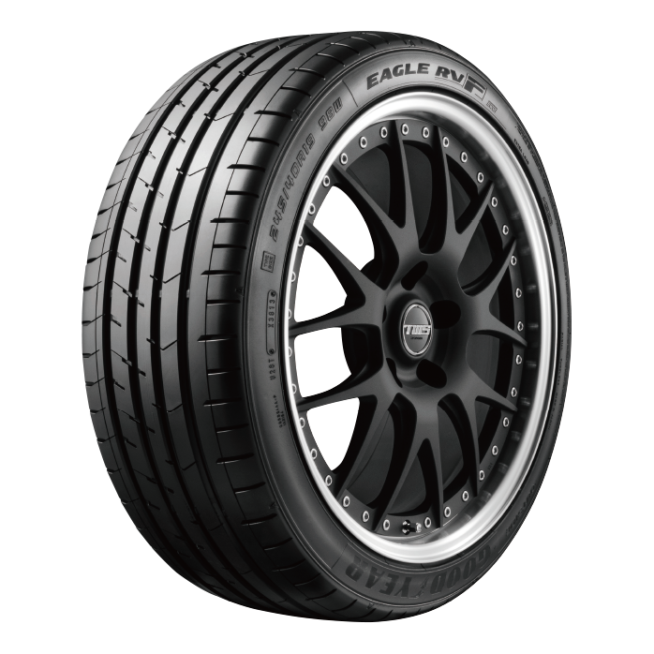
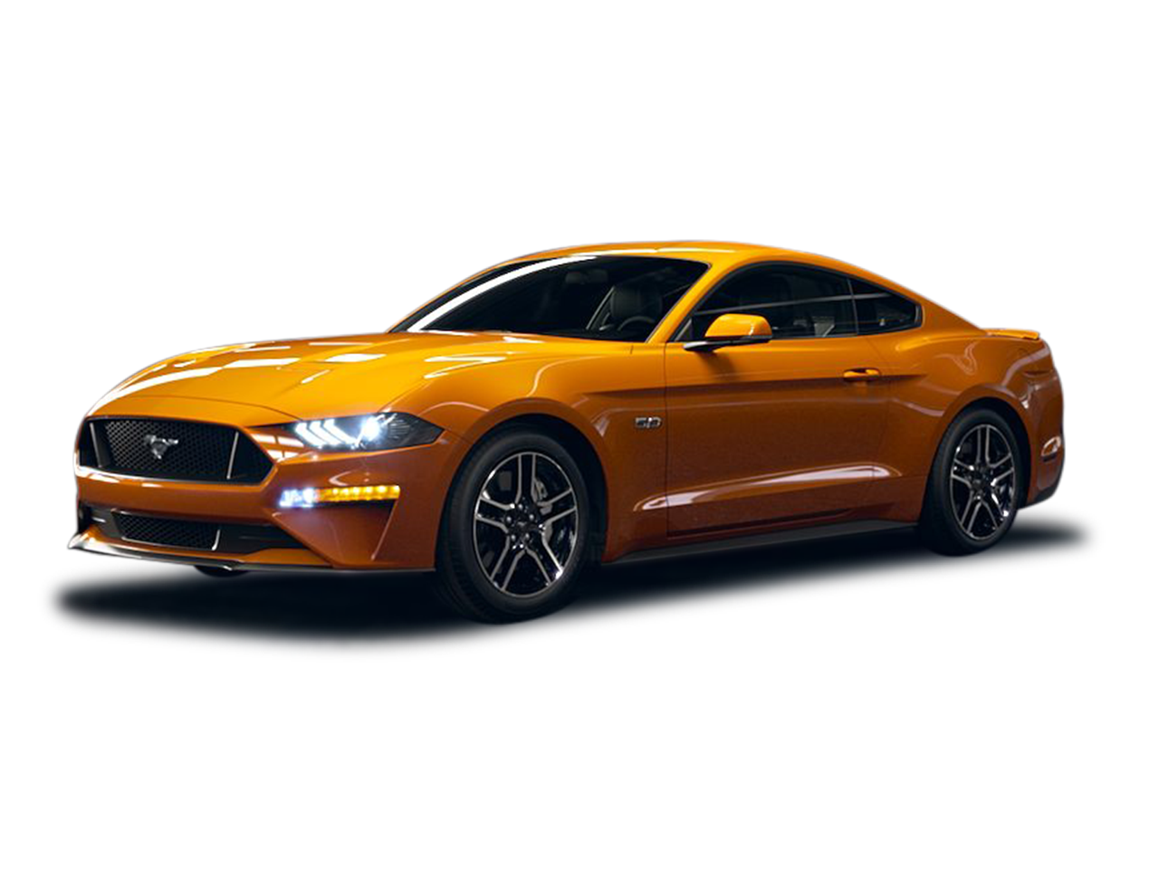

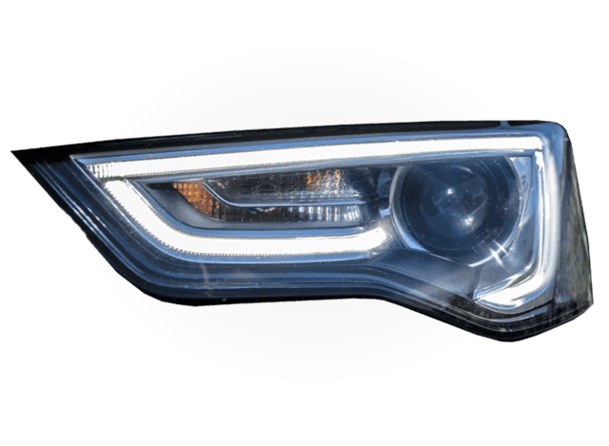

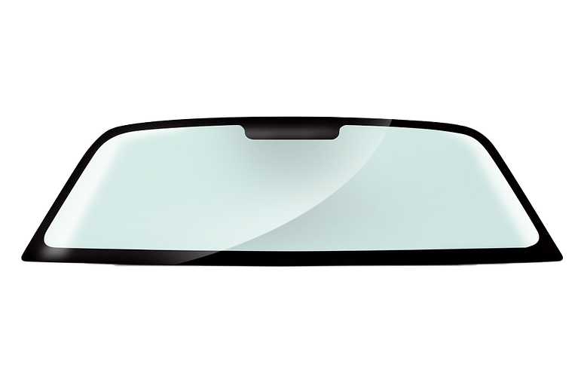

Slide 17
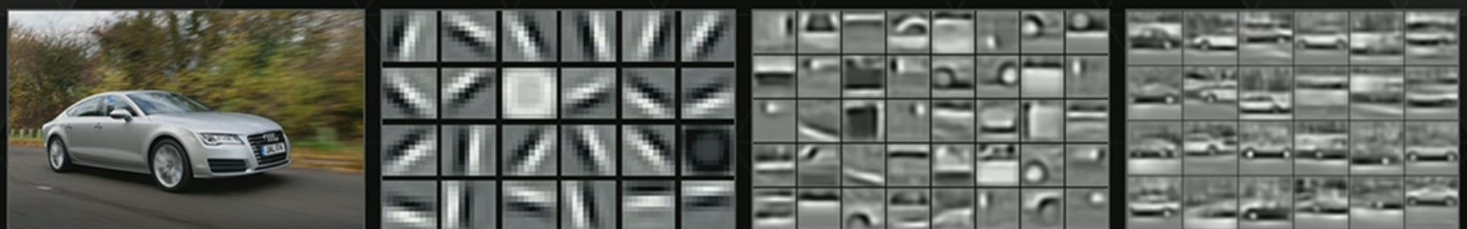

Slide 18
Transfer Learning

Slide 20
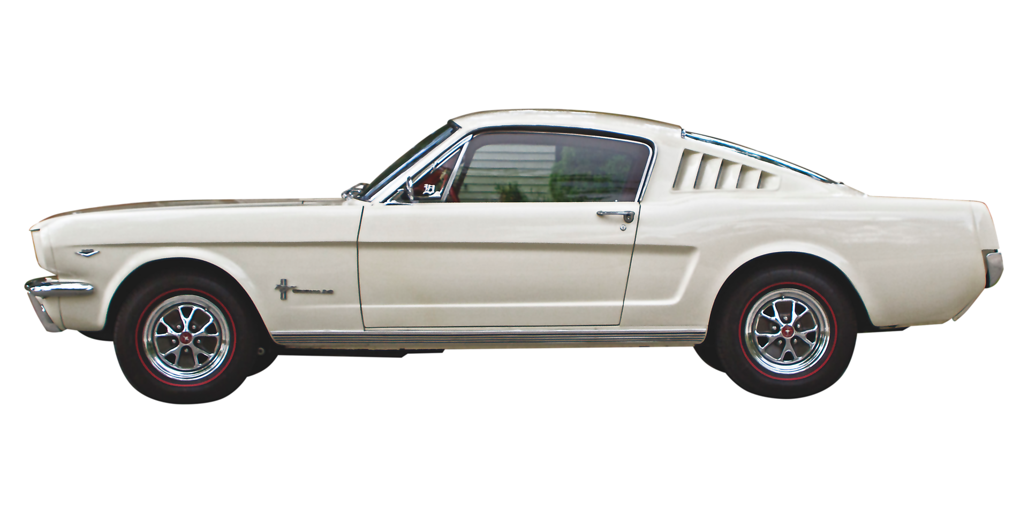
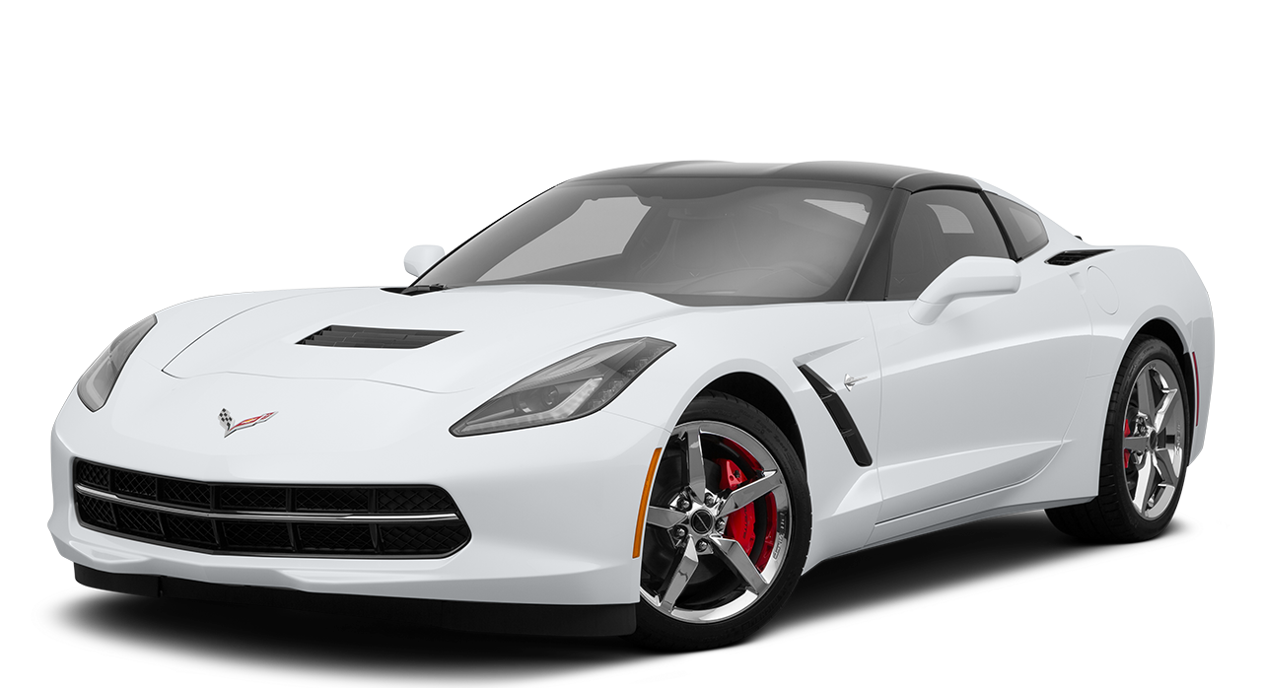

Slide 21
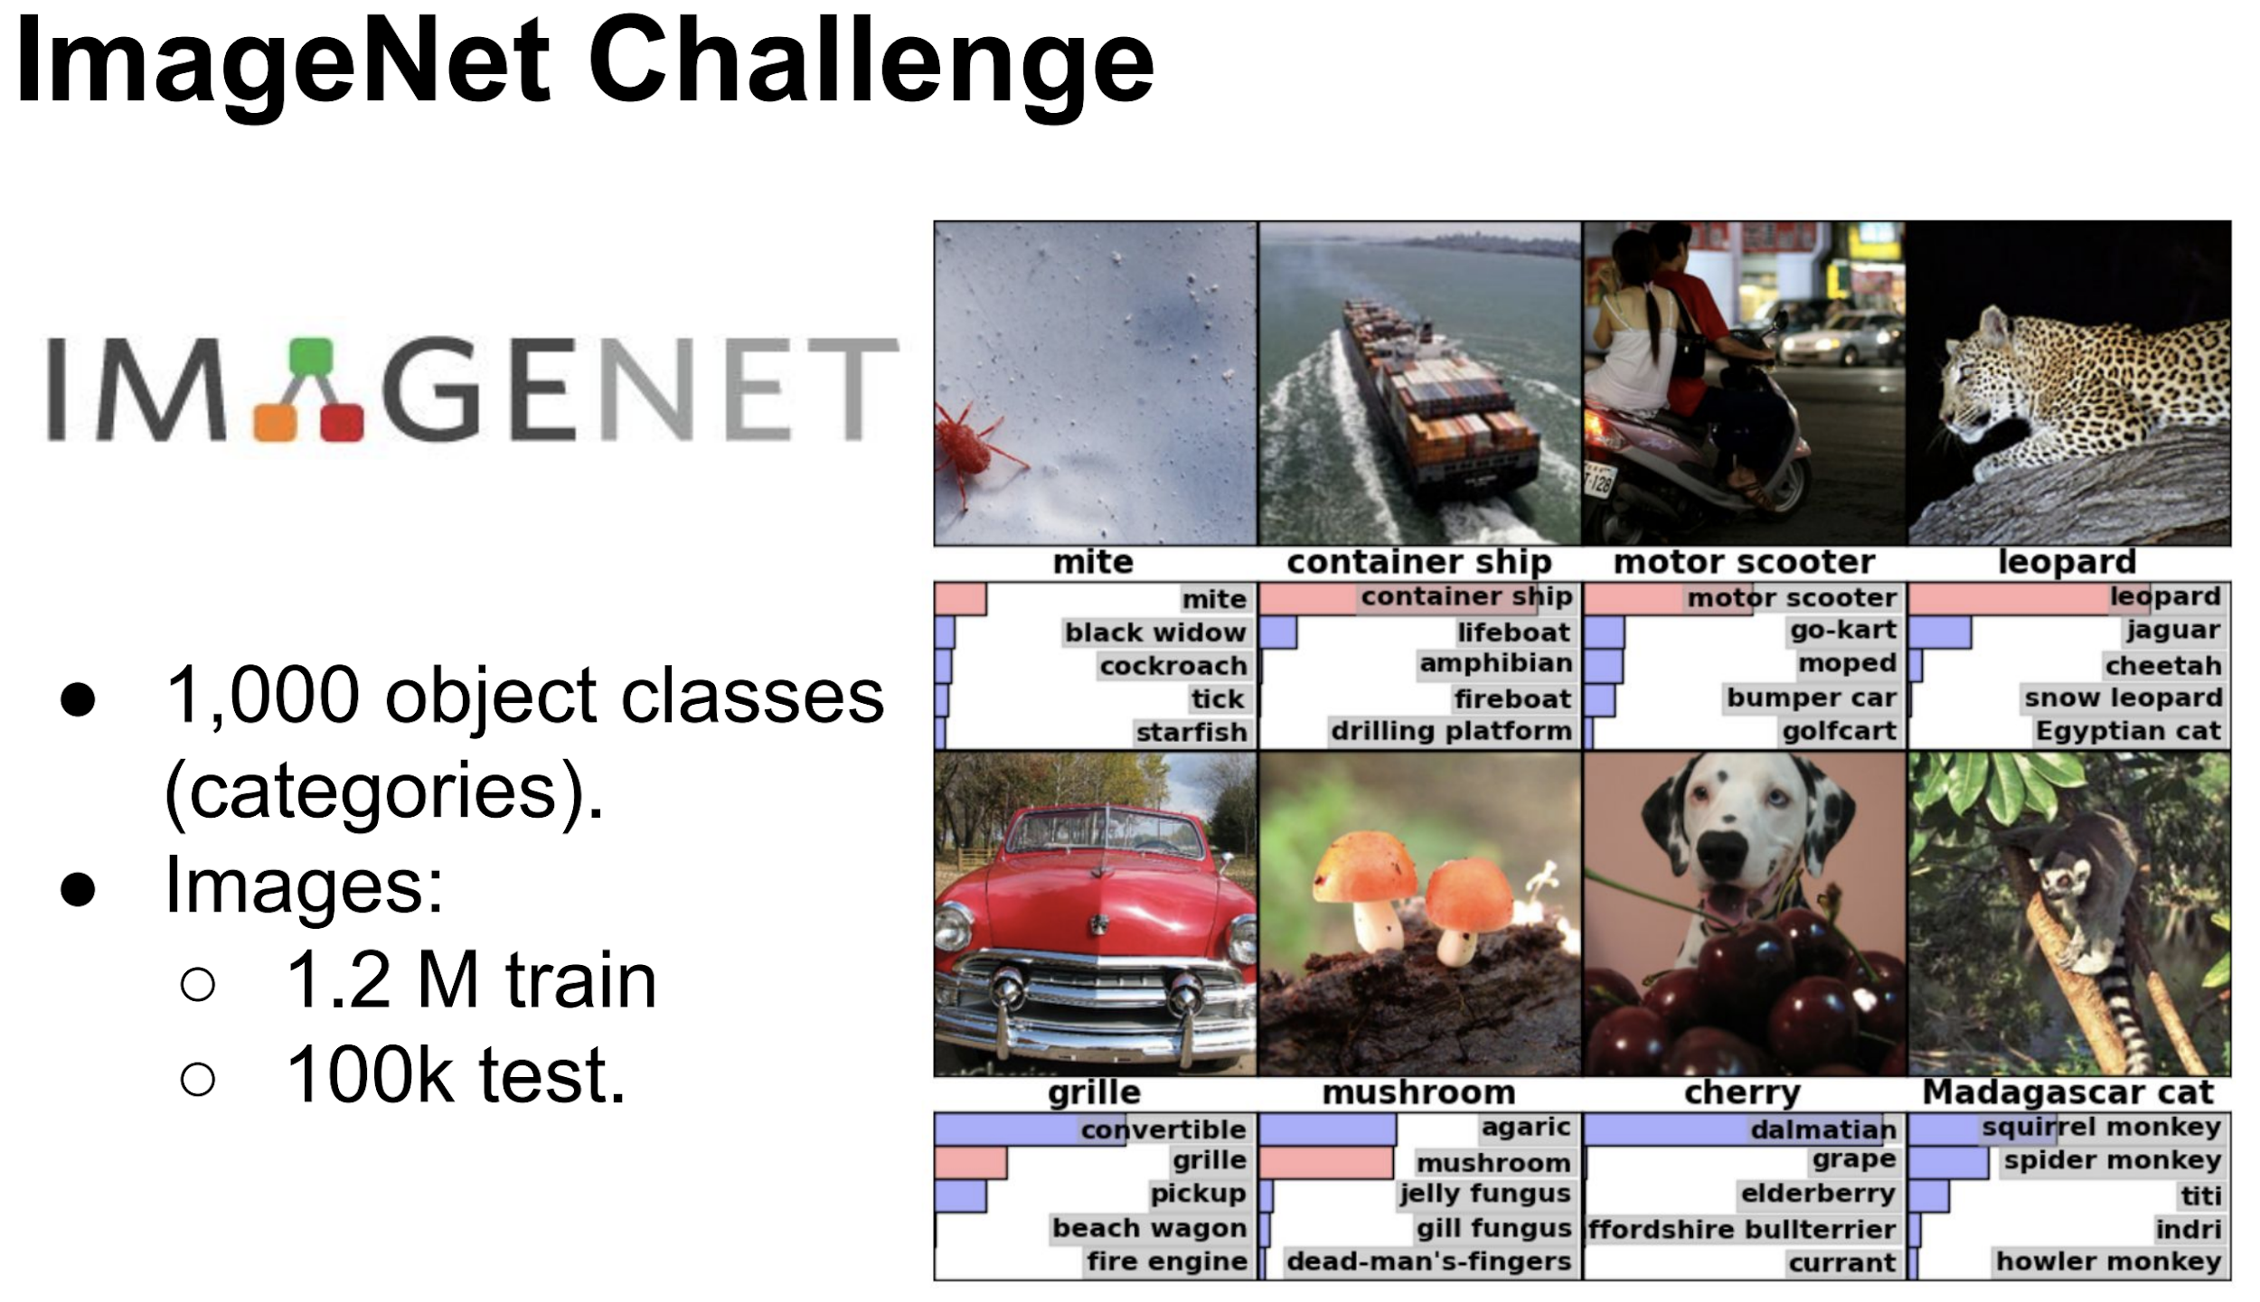

Slide 22
Training Process

Slide 23
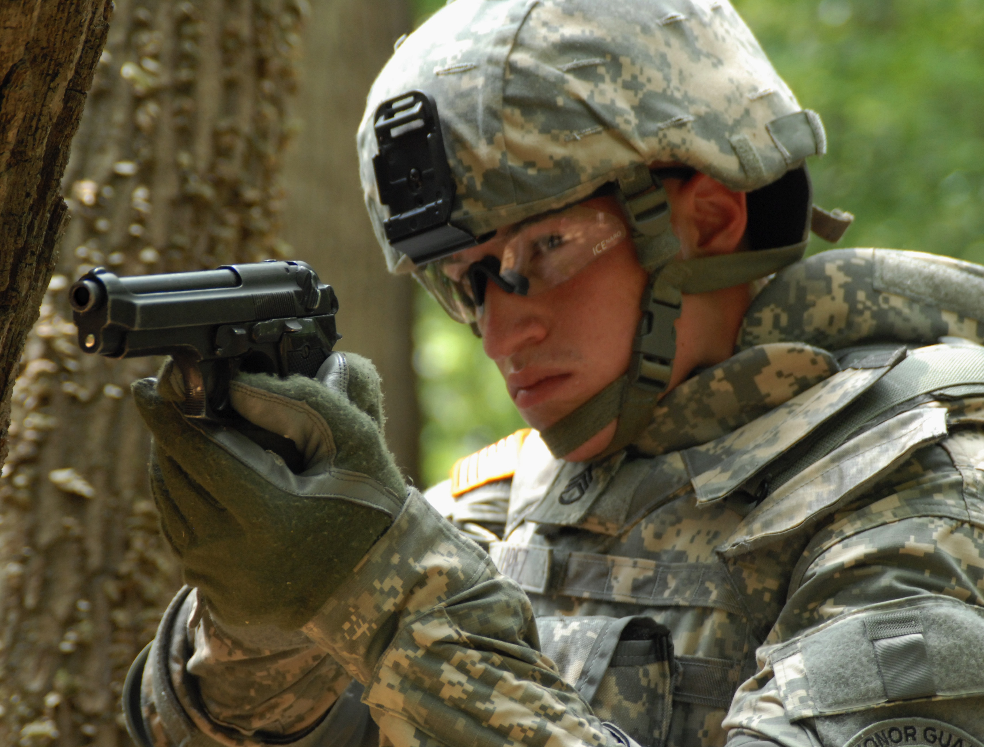
Ground Truth
Predicted
Area of Overlap
IoU =
Area of Union
Overlap
Union

Slide 24
How correct am I at finding the object?
Depending on the threshold we define
Area of Overlap
IoU =
=
Area of Union
Overlap
True Positive
True Negative
Union

Slide 25
Mean Average Precision (mAP)
50% IOU
mAP
Steps

Slide 26
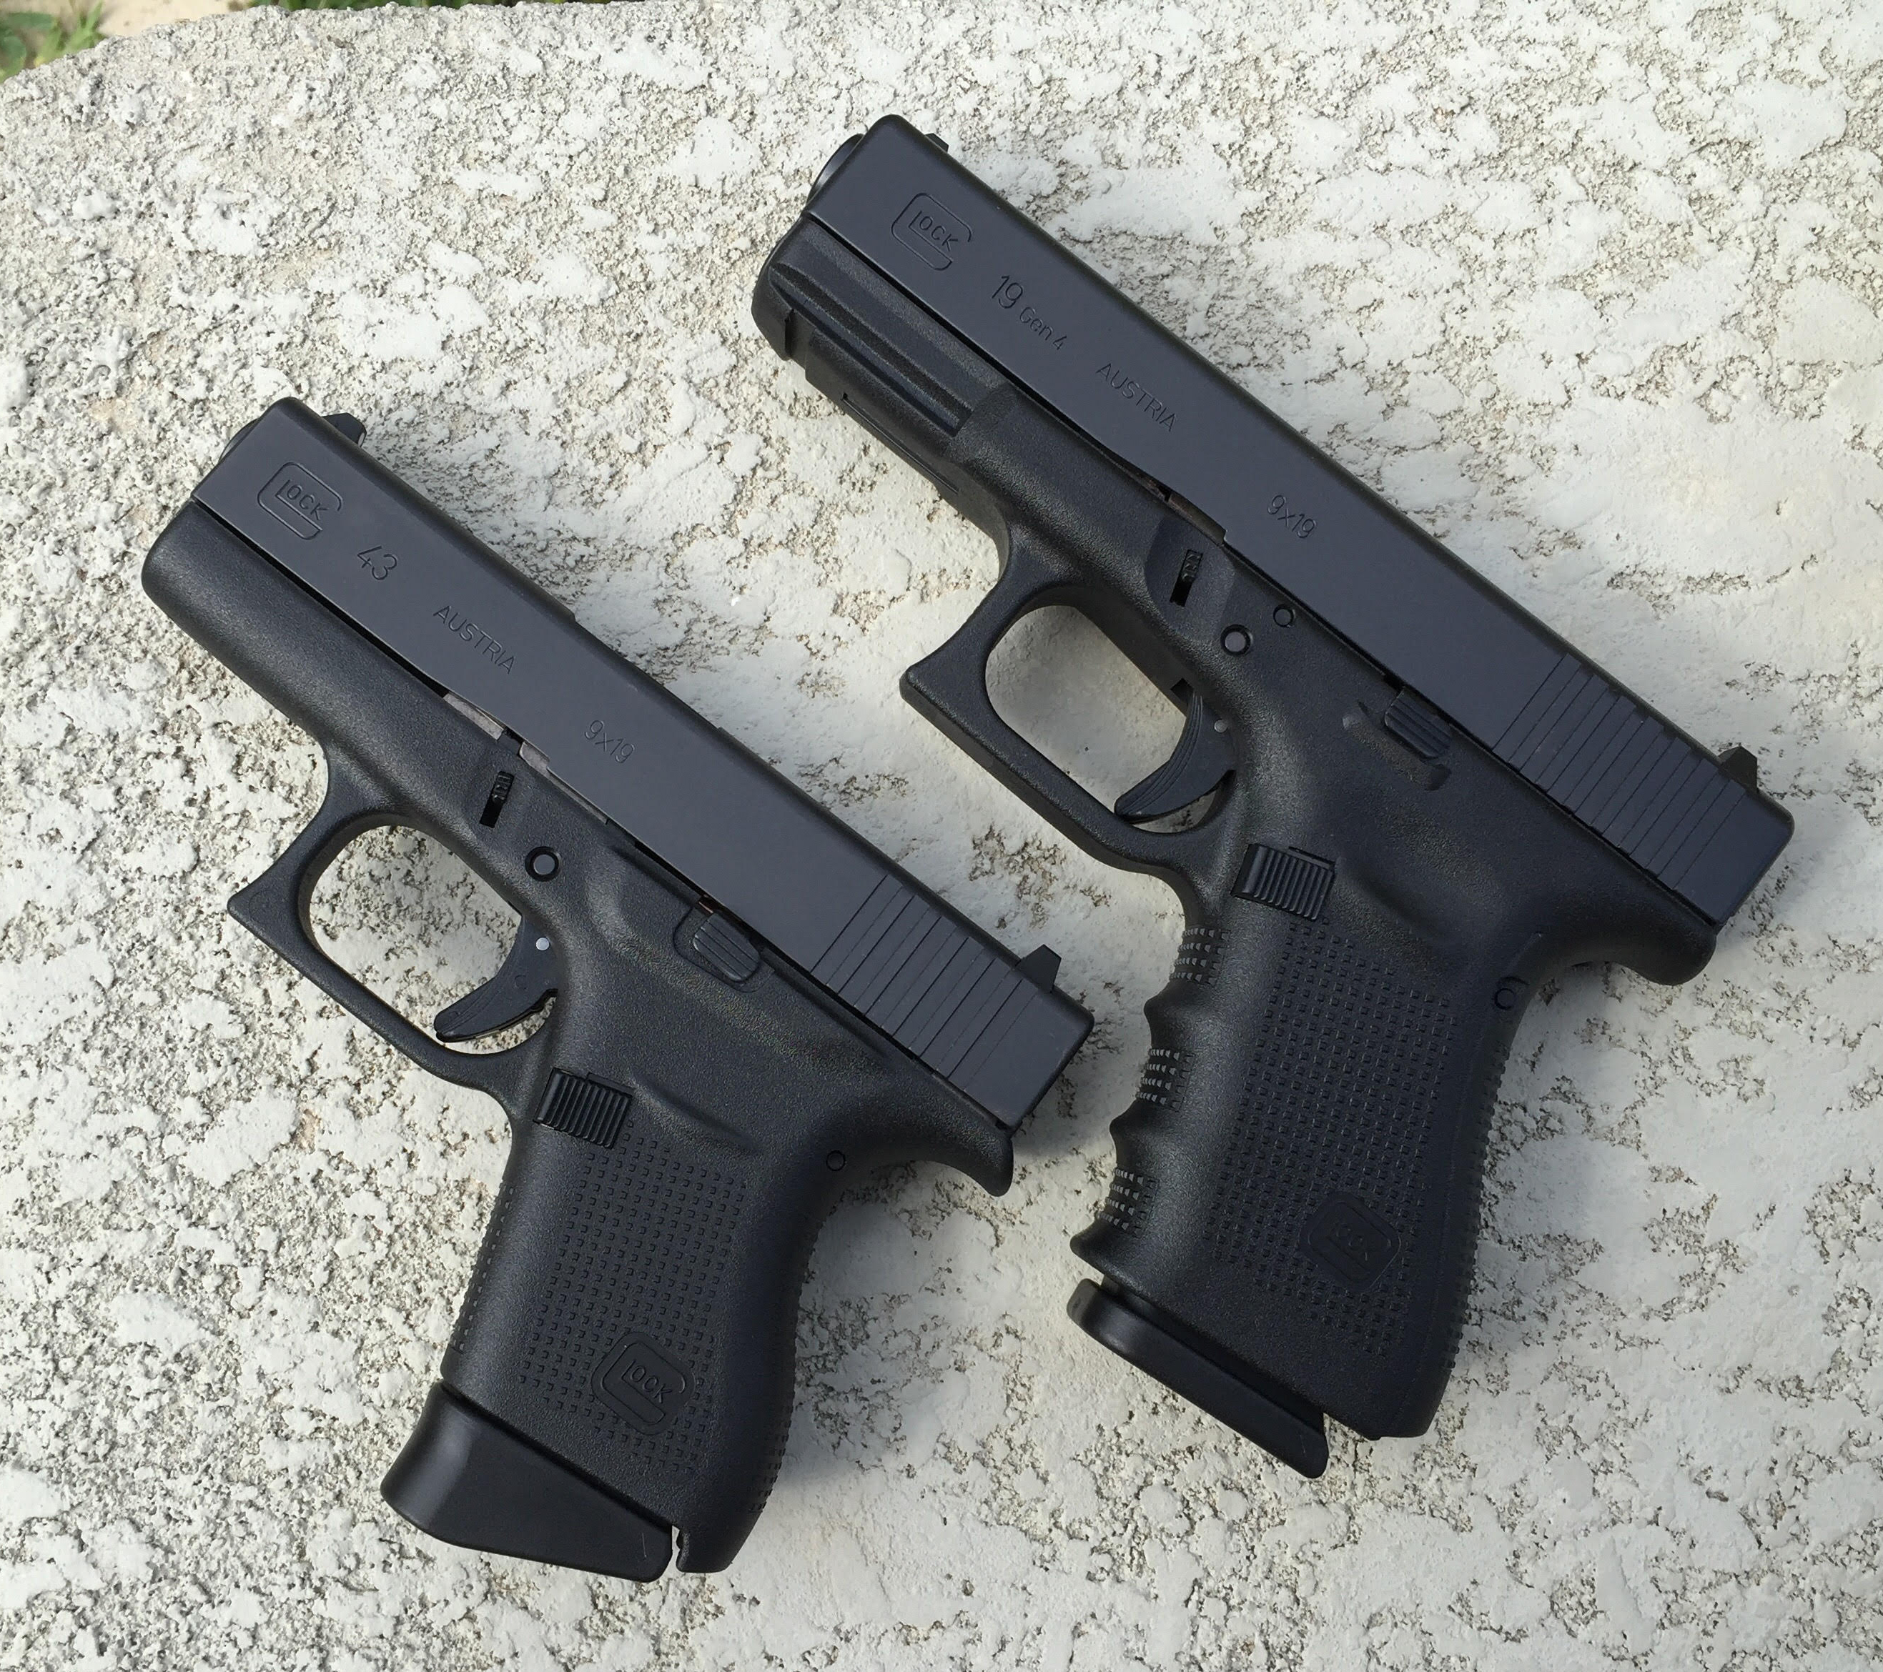
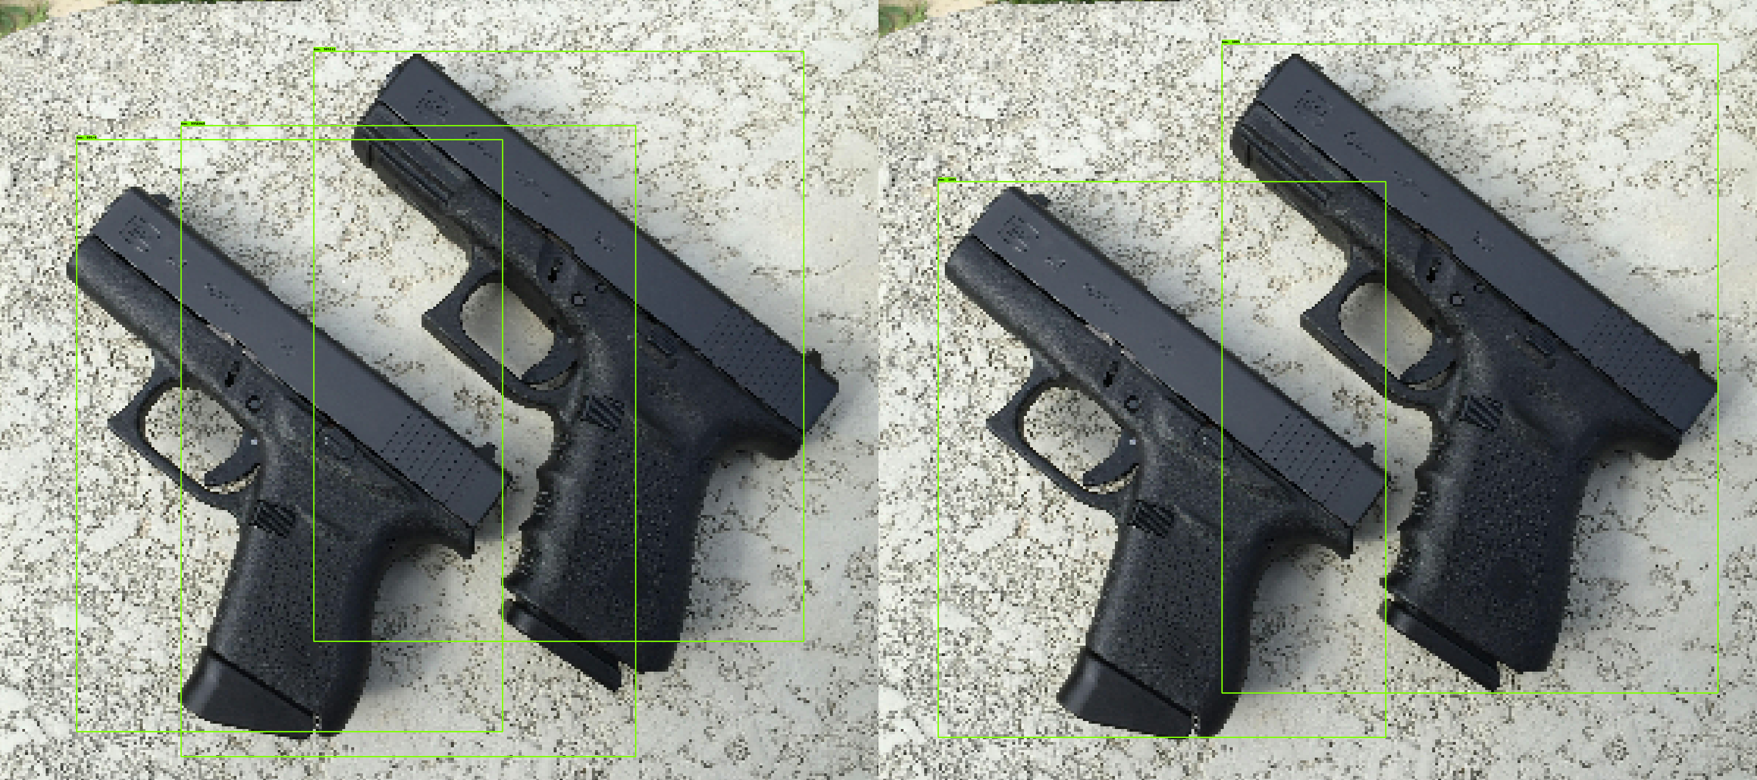
Step 2,700
Predicted
Ground Truth
Pistol 98 %
Pistol 100 %
Pistol 99 %
Pistol 100 %
Pistol 99 %

Slide 27
Step 24,000
Predicted
Ground Truth
Pistol 100 %
Pistol 98 %
Pistol 99 %
Pistol 100 %

Slide 28
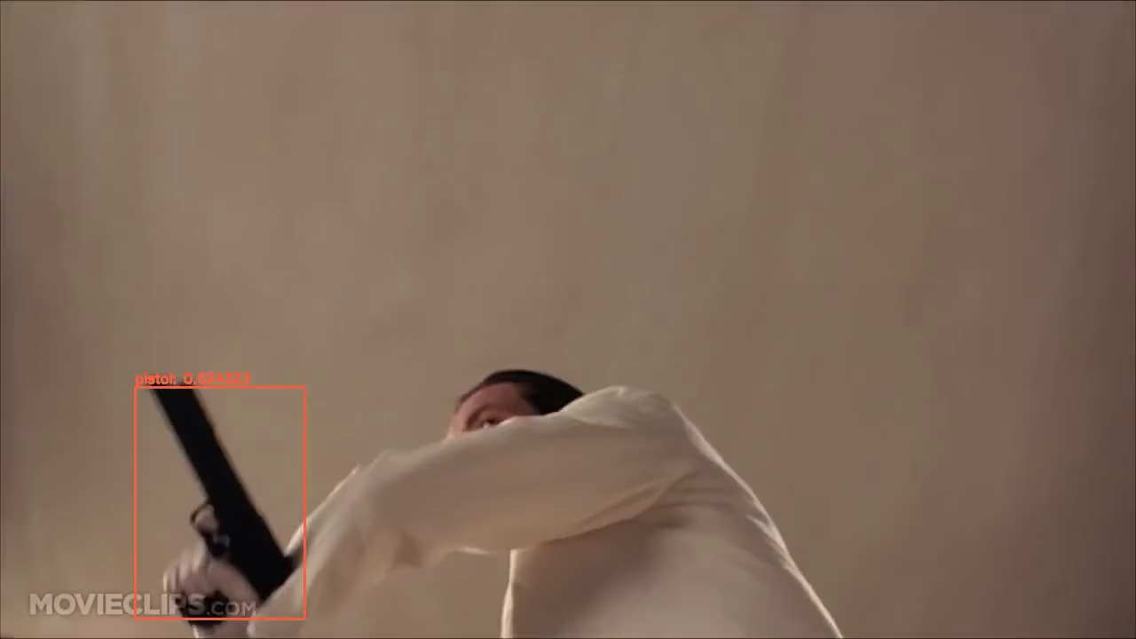

Slide 29
Thank You!

Slide 30


